Slide 1

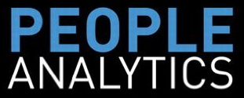
Building Competitive Advantage through People Data Driven

Slide 2

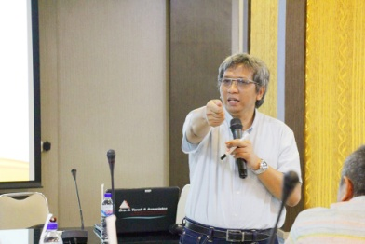
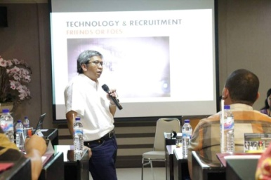
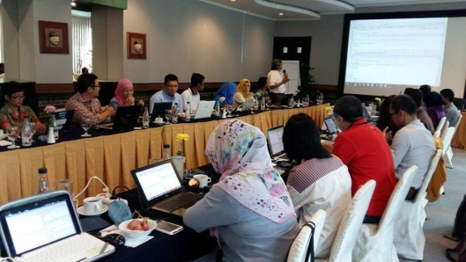
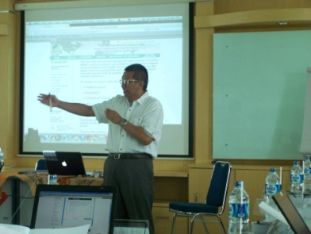
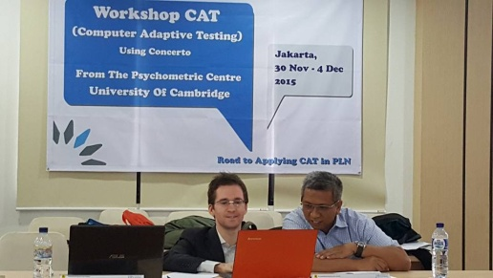


Slide 3
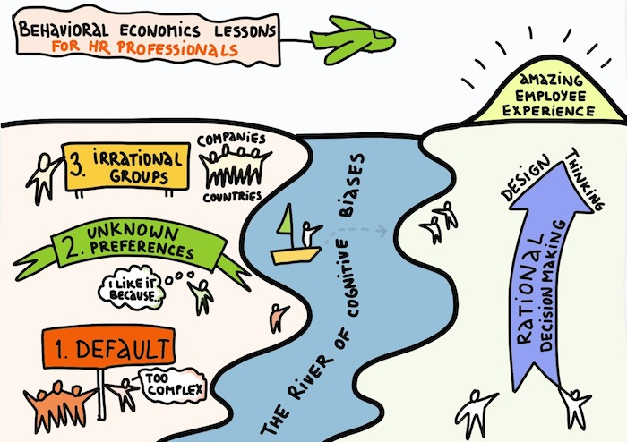

Slide 4
Application of technology to the HR function has changed dramatically
very powerful HR information systems that support the bulk of the transactional activity that HR engages in in most areas/functions of HR
usage of word processing, spreadsheet, presentation, and social media software at the individual user level in HR to increase their productivity at the individual level
the preparation of HR Metrics (in some organizations)- sometimes for internal Executive reporting purposes, and sometimes for external benchmarking purposes.
I have not seen as much of is robust statistical analysis of HR data for decision making purposes. That’s not saying use of statistical analysis on HR data hasn’t existed

Slide 5
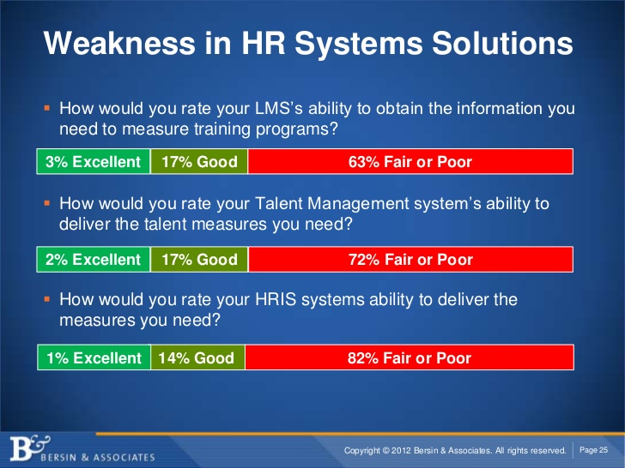

Slide 6
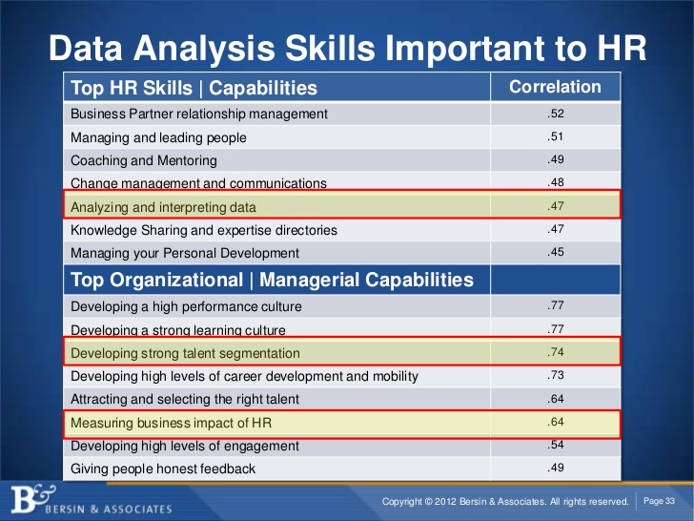

Slide 7
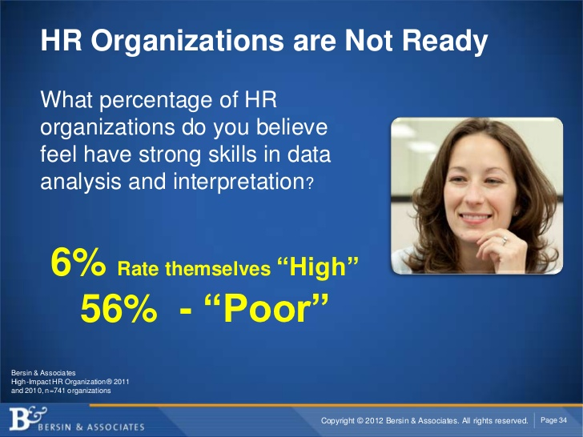

Slide 8
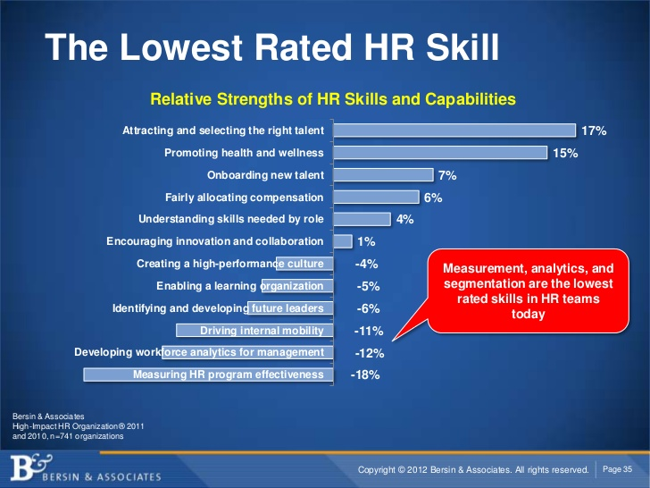

Slide 9
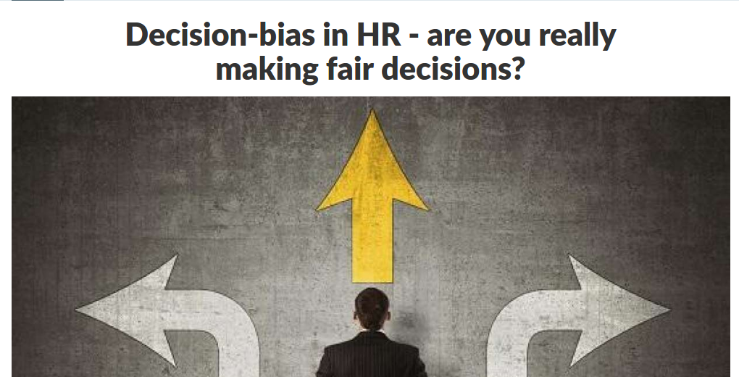

Slide 10
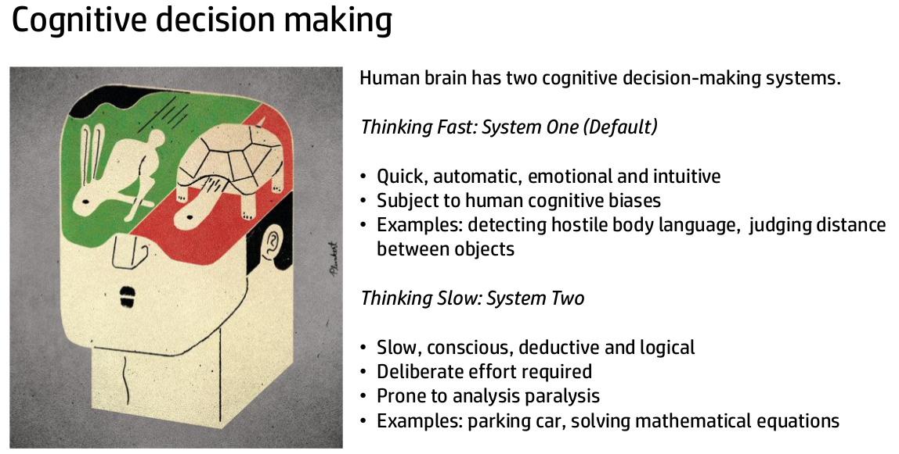

Slide 11
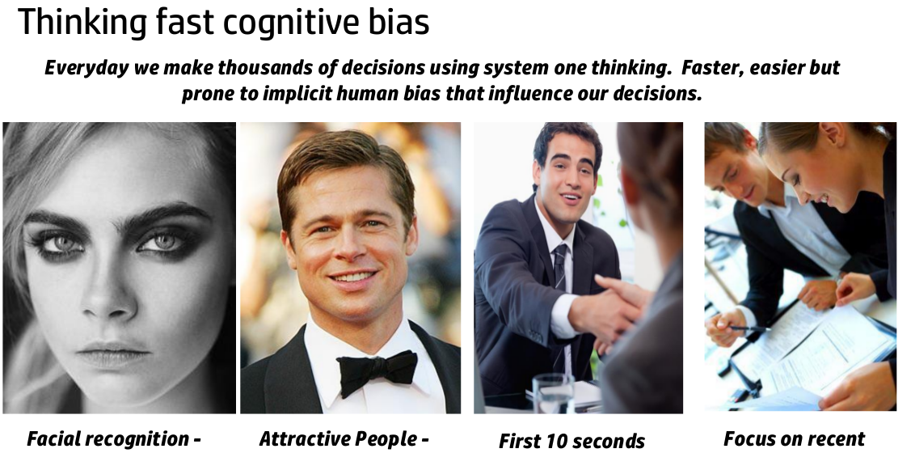

Slide 12
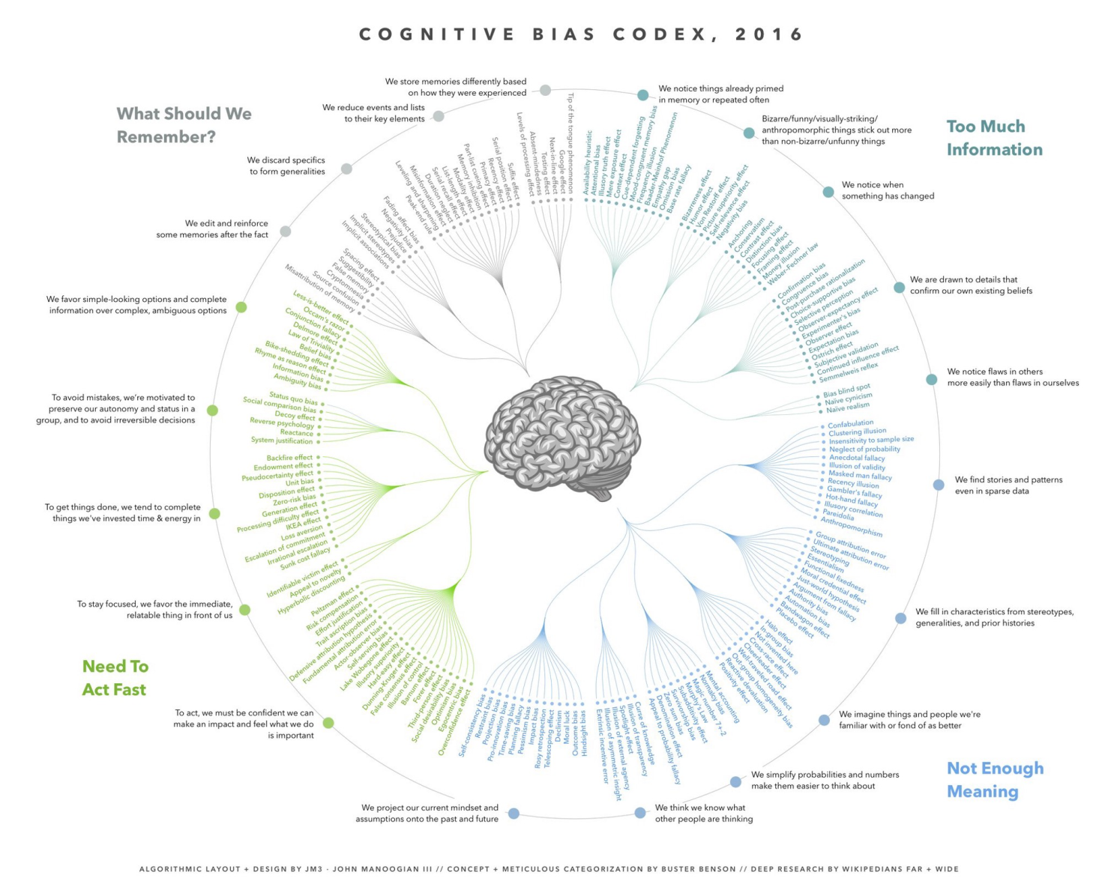

Slide 13
Cognitive Bias
Confirmation Bias
Confirmation bias is the tendency to process information in a way that confirms one’s preconceptions, beliefs, or hypotheses.
We exhibit a confirmation bias when we actively seek out and assign more priority and value to data that confirms our own hypotheses, and ignore or understate evidence that could mean otherwise.
You may have “good” preconceptions from educated intuition or previous experiences, but in most cases, those with a confirmation bias tend to ignore information and data that may disprove one’s own preconceived ideas, directly affecting the results of a study or analysis.

Slide 14
Cognitive Bias
Observation Bias
Observation bias is the tendency to look in places where it is expected to produce good results, or where it is very convenient to observe.
However, just because a source of data is easily accessible or is the first source that you thought of off the top of your head, it doesn’t mean it’s the most important.
It’s an understandable practice and it goes without saying that the most available and known data source is often a good source, but no data analysis is complete without building a complete picture of your data.
Data science is about producing actionable insights, but if only the wrong things are being observed and measured, you start getting false insights. Perhaps, to be an efficient researcher, it would be great to check yourself and frequently ask, “Am I measuring the right things? Are there better sources from which to get data from?”.

Slide 15
Cognitive Bias
Funding Bias
This one is pretty simple. Funding bias, sometimes called sponsorship bias, is the unconscious tendency to skew models, data, or interpretations of data in a way that favors the objectives of a financial sponsor or employer.
Here’s a prime example of a funding bias: it’s well known that in the 1990’s, the tobacco industry funded a number of research studies on the effects of tobacco and smoking cigarettes. In these studies, the industry sponsors and research centers were found to present findings in a misleading way and withhold certain findings about the relationships between smoking and cancer. Any scientist and researcher should take care to keep this bias in mind, because no matter how attractive, unknowingly making a business decision with flawed data will ultimately damage your company or sponsor, and might even damage your career (not to mention that this is just bad science)!

Slide 16
Cognitive Bias
Sampling Bias
Because of the sheer amount of time and resources needed to experiment on a whole population, we instead take a sample, which should be representative of a whole population.
This is usually achieved by a range of statistical techniques and well-designed randomization, but what happens if proper randomization isn’t achieved? It’s not uncommon for researchers to encounter a sampling bias, in which the selection of groups or data is unintentionally not representative of the population to be experimented on. In any kind of experimentation, no matter how big or diverse the sample, there is always the possibility that there is an inconsistency in data and sample collection. This bias also ties into the three other biases mentioned above; if any of these biases unconsciously influences the way in which you collect data or samples for your research or experiment, then you’re also experiencing a sampling bias!

Slide 17
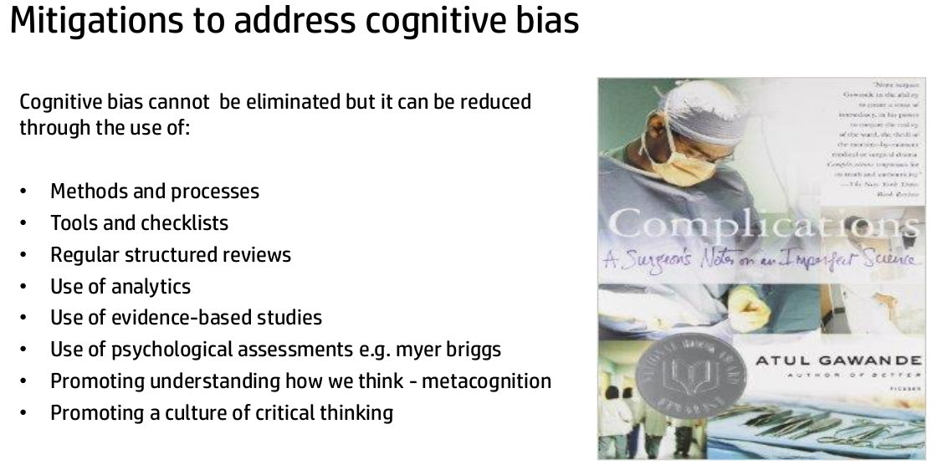

Slide 18
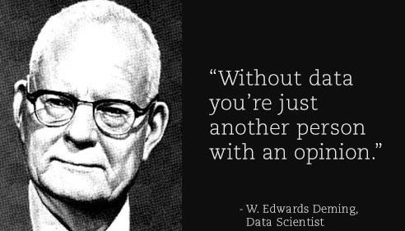
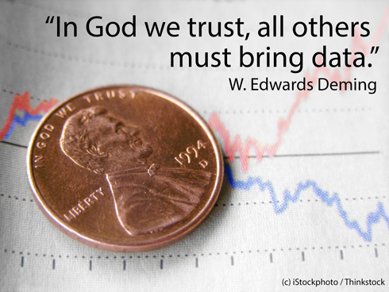
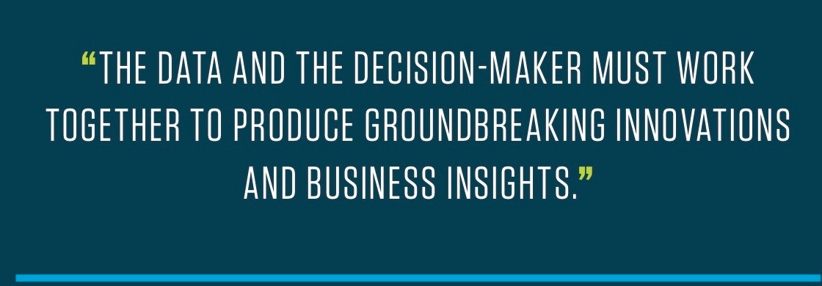

Slide 19
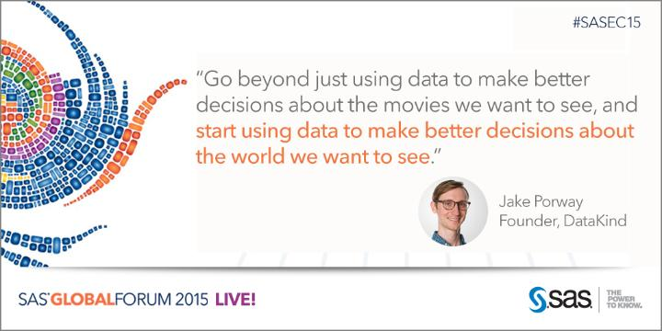
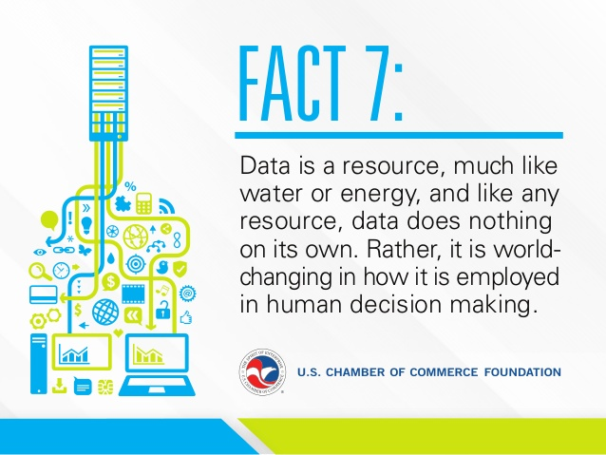
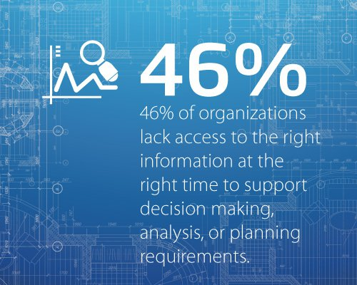

Slide 20
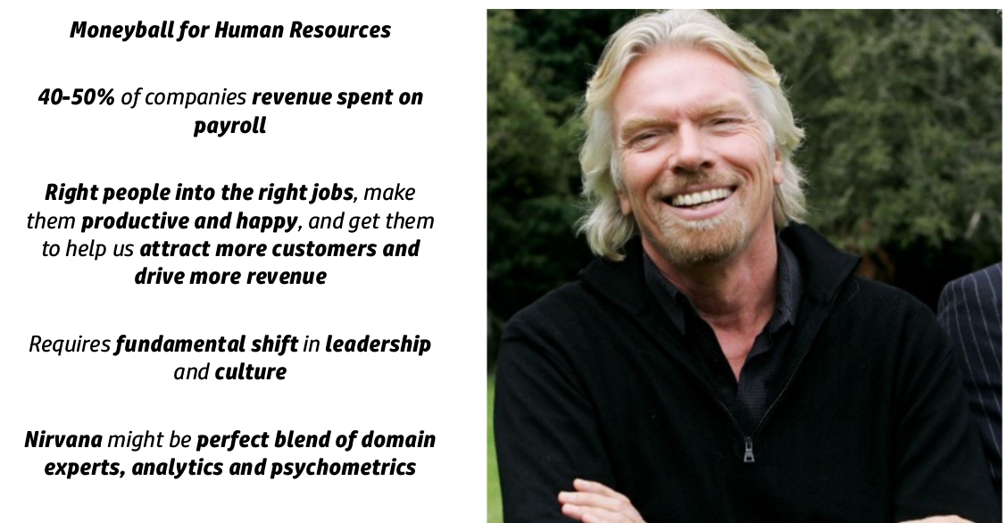

Slide 21
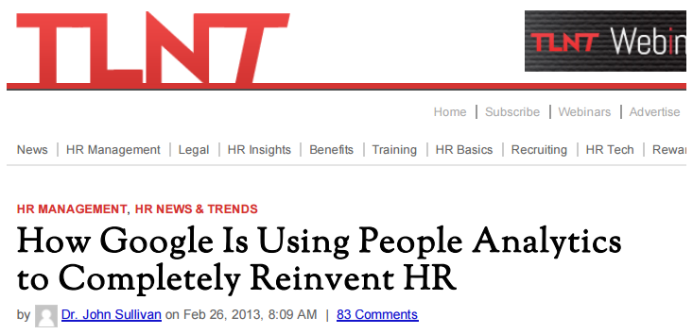
“People analytics is a data-driven approach to managing people at work. Those working in people analytics strive to bring data and sophisticated analysis to bear on people-related issues, such as recruiting, performance evaluation, leadership, hiring and promotion, job and team design, and compensation …

Slide 22
Workforce/HR/People analytics are a ‘data driven’ approach to managing people at work. What would be implied in this is that it isn’t data just for the sake of data, but data for a purpose. It implies that when you make HR decisions, you need to be able to show from your own internal research and data, why you are taking the actions you do
The scope of a ‘data driven’ approach covers ALL HR functions and practices. The potential of Analytics to ‘reinvent’ HR can impact everything. The scope is not just HR Department improvement but organizational improvement through the correlation of HR data to business data. It is about what we do, how we do it, and what impact that is really having on the organization.
‘Data driven’ implies ‘data’. It may seem trite to say that, but to have ‘data’ means that we are measuring. This typically means metrics – not just transactional metrics but performance metrics as well. (not just what are we doing , but how well we are doing it)
Analytics and metrics aren’t just about HR data but are also about their tie to business data. It’s not just about HR Department improvement but organizational improvement through the correlation of HR data to business data. It is about what we do, how we do it, and what impact we are really having on the organization, as HR professionals.
Notes:
Workforce/HR/People analytics are a ‘data driven’ approach to managing people at work. What would be implied in this is that it isn’t data just for the sake of data, but data for a purpose. It implies that when you make HR decisions, you need to be able to show from your own internal research and data, why you are taking the actions you do
The scope of a ‘data driven’ approach covers ALL HR functions and practices. The potential of Analytics to ‘reinvent’ HR can impact everything. The scope is not just HR Department improvement but organizational improvement through the correlation of HR data to business data. It is about what we do, how we do it, and what impact that is really having on the organization.
‘Data driven’ implies ‘data’. It may seem trite to say that, but to have ‘data’ means that we are measuring. This typically means metrics – not just transactional metrics but performance metrics as well. (not just what are we doing , but how well we are doing it)
Analytics and metrics aren’t just about HR data but are also about their tie to business data. It’s not just about HR Department improvement but organizational improvement through the correlation of HR data to business data. It is about what we do, how we do it, and what impact we are really having on the organization, as HR professionals.
Analytics are not just armchair empiricism, but rather the application of statistical analysis tools to HR data and metrics. It goes beyond a sense or a gut feel. At best a gut feel or sense is a ‘hypothesis’ that should be subject to confirmation by data.
The ‘purpose’ of analytics is for performance improvement whether at individual. HR Department/Operations or at the organizational/business outcome level. This means more accurate, more proactive (predictive) and less reactive decisions, quicker and more productive and efficient HR decisions.
In statistical terms, the scope of analytics could cover prediction, correlation, and process quality improvement tools and possibly other areas as well.

Slide 23
Analytics are not just armchair empiricism, but rather the application of statistical analysis tools to HR data and metrics. It goes beyond a sense or a gut feel. At best a gut feel or sense is a ‘hypothesis’ that should be subject to confirmation by data.
The ‘purpose’ of analytics is for performance improvement whether at individual. HR Department/Operations or at the organizational/business outcome level. This means more accurate, more proactive (predictive) and less reactive decisions, quicker and more productive and efficient HR decisions.
In statistical terms, the scope of analytics could cover prediction, correlation, and process quality improvement tools and possibly other areas as well.

Slide 24
“The basic premise of the “people analytics” approach is that accurate people management decisions are the most important and impactful decisions that a firm can make. You simply can’t produce superior business results unless your managers are making accurate people management decisions.”
If you aren’t collecting the data, measuring, and doing the analysis – how do you know you are producing superior results?

Slide 25
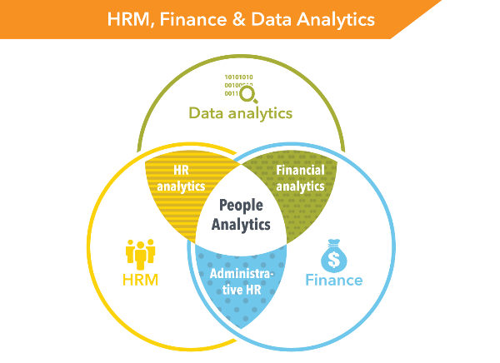

Slide 26
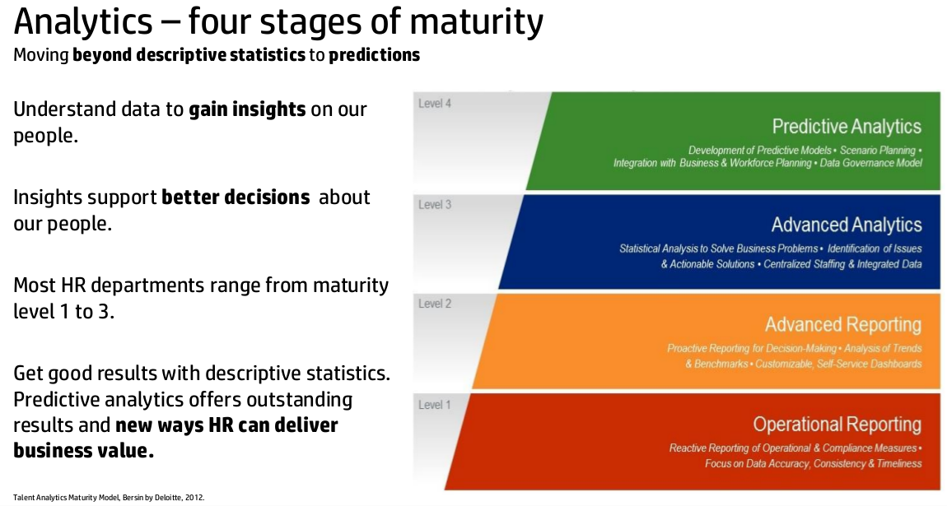

Slide 27
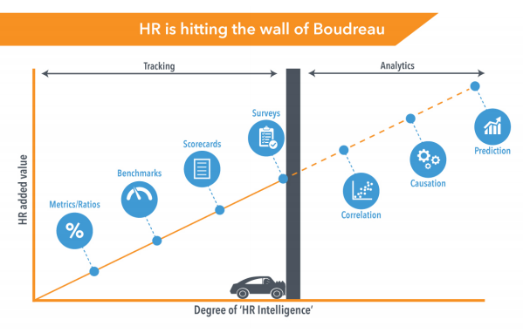

Slide 28
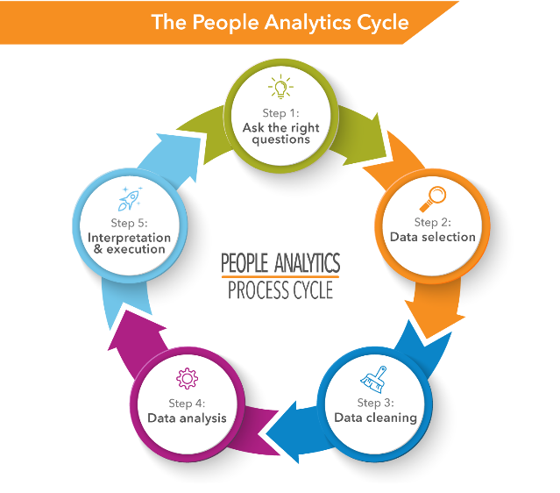

Slide 29
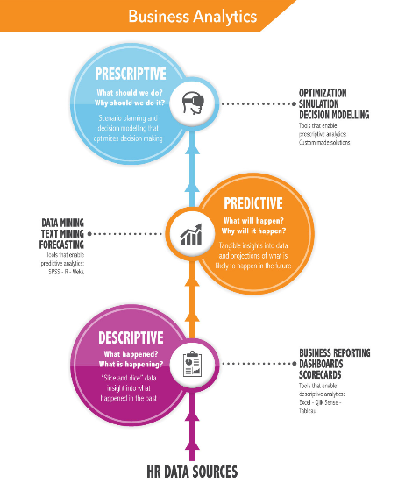

Slide 30
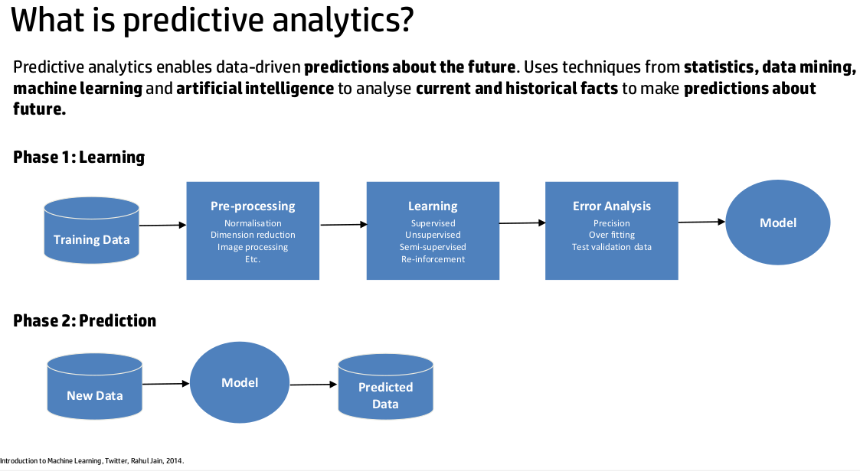

Slide 31
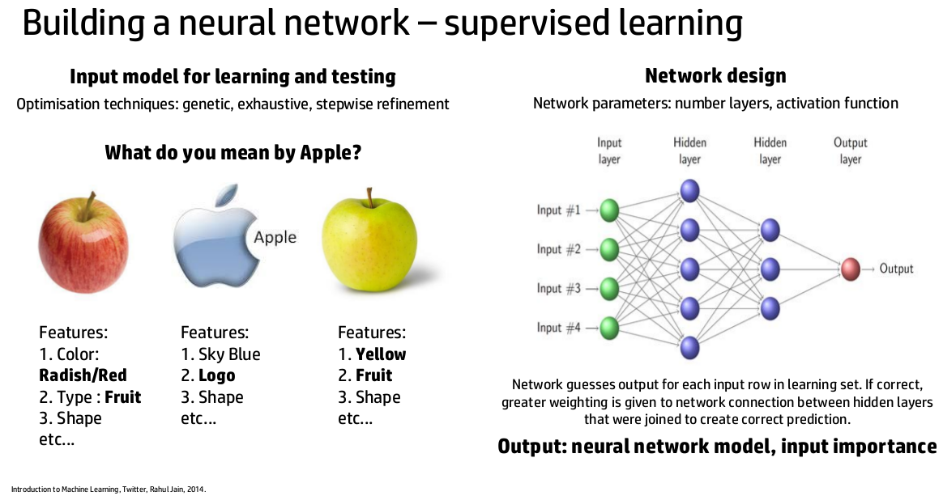

Slide 32
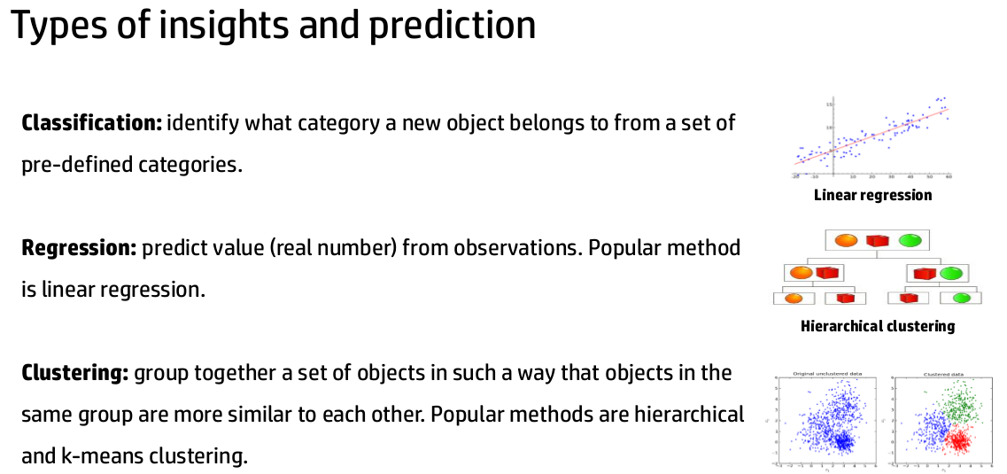

Slide 33
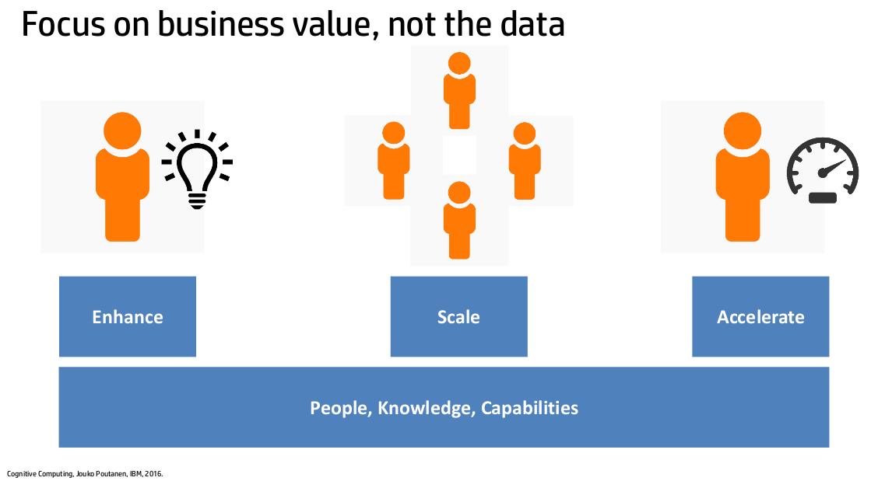

Slide 34
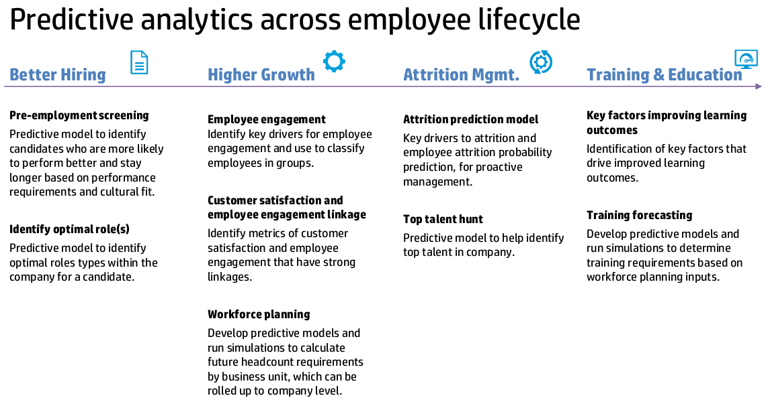

Slide 35
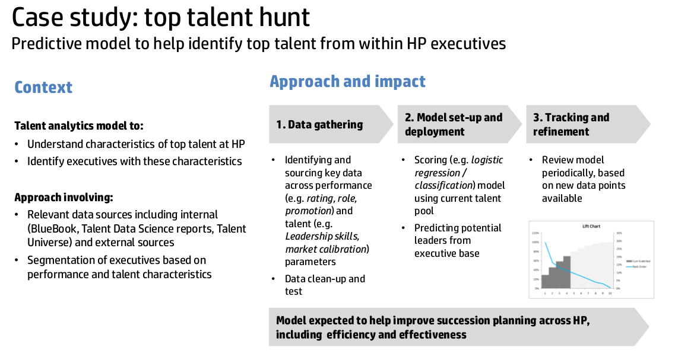

Slide 36
PEOPLE ANALYTICS IN ACTION
PREDICTIVE ANALYTICS IN HR
People Analytics : case study of
Why are our best and most experienced employees leaving prematurely?
People Analytics : case study of
Young People Survey: Explore the preferences, interests, habits, opinions, and fears of young people

Slide 37
How Might HR Professionals
Respond To This?
“The basic premise of the “people analytics” approach is that accurate people management decisions are the most important and impactful decisions that a firm can make. You simply can’t produce superior business results unless your managers are making accurate people management decisions.”
If you don’t agree with the premise and that you don’t see the need for managing people in organizations as needing to be data driven, it’s unlikely you will see this as a wakeup call and feel a need to respond. Ultimately that is every organization’s and HR practitioner’s decision and choice.
If you do decide that this is relevant to you personally as an HR practitioner or as an HR function in an organization, or as an organization in general, then I think there are many things that are conducive to moving in the direction of leveraging analytics to make ‘data driven’ people management decisions.

Slide 38
Things to DO
Start reading, researching and staying on top of developments in this area.
Take claim to HR analytics as part of the HR domain.
See your ‘hands on’ use of the technology to do this as both an extension of who you are as an HR professional and as a tool for increasing your competitiveness.
Be smart in your use (or not) of prepackaged vendor analytics software solutions.
Increase your knowledge of statistics and statistical analysis.
Possibly change your paradigm of HR.

Slide 39
Final Thoughts
Workforce/ HR/ People analytics are still in their early stages of use and terminology in HR. Even with that being the case, what is at the heart of the use and terminology for this is ‘data driven’ decision making. ‘Data driven’ goes beyond simply producing metrics. It is:
Being able to take a HR issue or question, understand what data exists around and available for that decision, understand what statistical analyses or summaries are useful to answer that question, presenting that data as part of the decision and decision making process
Understanding for our existing metrics, why we produce them in the first place and what questions they were intended to answer.
Being able to take overall metrics, measures, and data and be able to slice and dice understand underlying relationships.
Making a decision as HR professionals to be ‘data driven’. As I mentioned earlier in this article, the ability to generate datasets of HR data and availability of applying statistical tools has been around for at least 35 years. The technologies have changed and have become more robust, and the amount and scope of data has increased over that period of time. The tools and data needed to do this are not necessarily an obstacle.
Google is indeed doing some tremendously exciting things in their People practices. They have taken the bold move to increase dramatically their ability to be ‘data driven’ in their HR practices. And they will likely continue to see payoffs for their decisions.
We guess the key question is- how will Workforce, HR, People Analytics impact you and your organization?

Slide 40
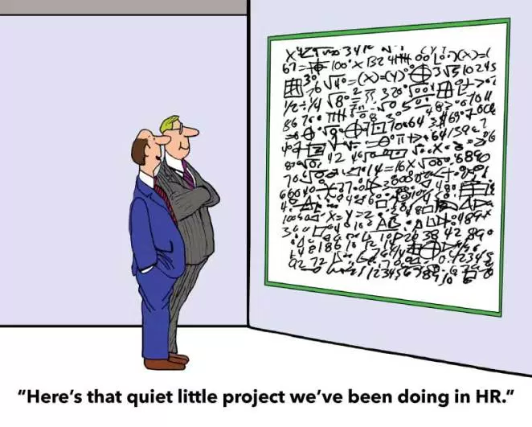
Five reasons
HR analytics projects fail
The project is too ambitious

Slide 41
Five reasons
HR analytics projects fail
Lack of relevance to the business

Slide 42
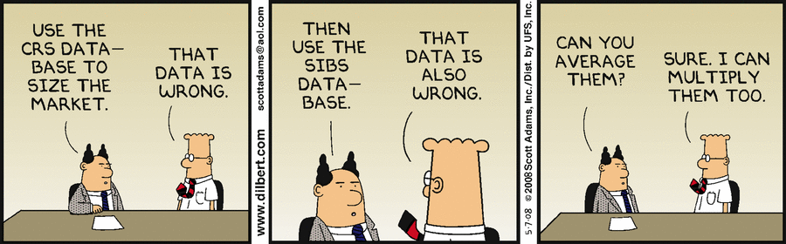
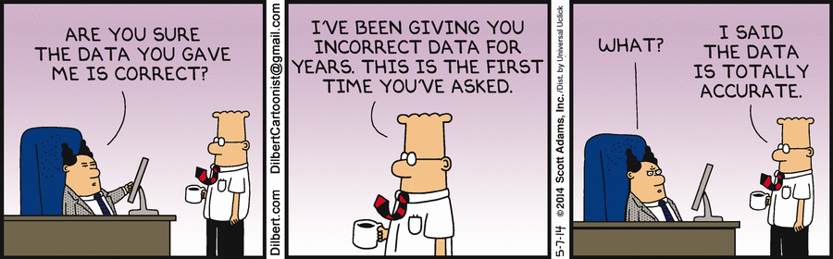
Five reasons
HR analytics projects fail
Bad data

Slide 43
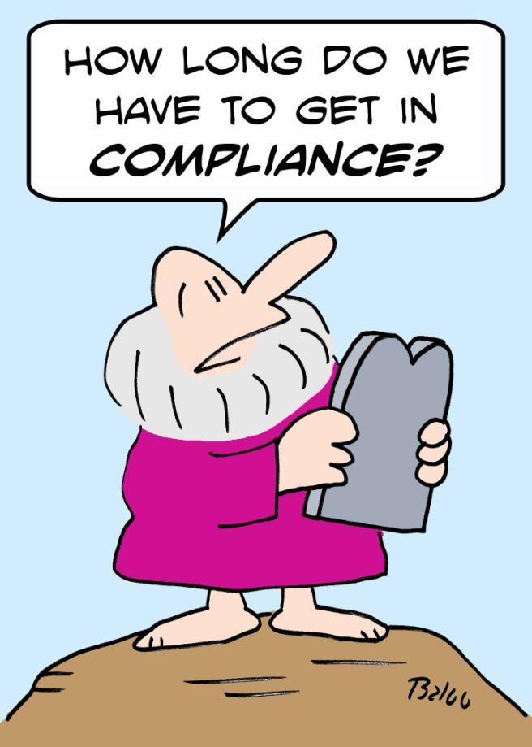
Five reasons
HR analytics projects fail
Compliance was not factored in from the beginning

Slide 44
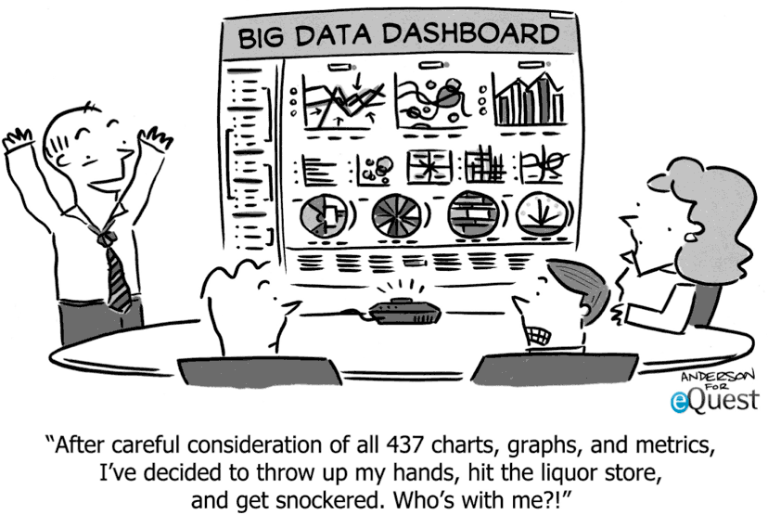
Five reasons
HR analytics projects fail
No translation to actionable insights

Slide 45


